Slide 1


Time-Step Change in Thermosphere Temperature modeled using Runge Kutta 4th Order Method
Group 2: Project B
Space Weather Simulation Summer School 2022
Aliaa A. M. Afify, University of New Brunswick
Onyinye Nwankwo, University of Michigan
July 29th , 2022

Slide 2

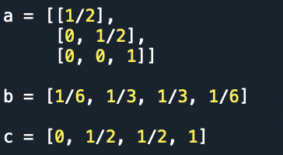
Steps Taken in the Modeling
Create an explicit RK stepper for the explicit ODE that we were given. And for the time stepping, we decided to use the 5 minutes time step for a time span of 24 hours (1440 minutes).
2. Create a source code where we defined a, b, and c using a simple Butcher tableau of the format:
We decide to use this Butcher tableau method because of the primary advantage it offers.
The primary advantage this method has is that almost all of the error coefficients are smaller than in the popular method.

Slide 3
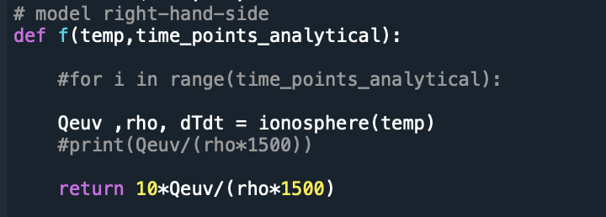
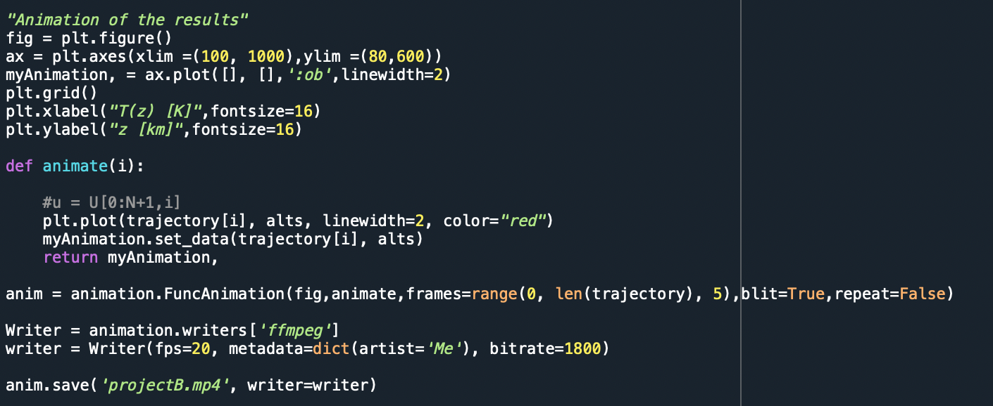
Steps Taken in the Modeling Cont’d
3. Then we define a function called ionosphere to get the values of Qeuv and rho from EUVAC model as a function of solar zenith angle.
4. Then, we integrate over the time our f(T, t) for each value of altitude that we have; after that we make an animation with Temperature versus altitude changing with time.

Slide 4
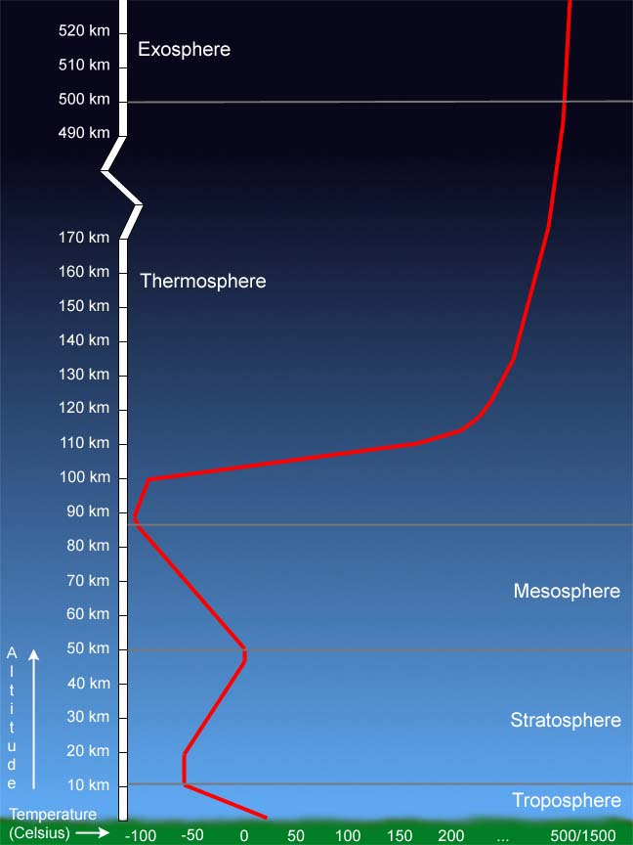
Thermosphere Temperature in Reality
Temperatures climb sharply in the lower thermosphere (below 200 to 300 km altitude), then level off and hold fairly steady with increasing altitude above that height.
Solar activity strongly influences temperature in the thermosphere.
The thermosphere is typically about 200 K hotter in the daytime than at nighttime.

Slide 5
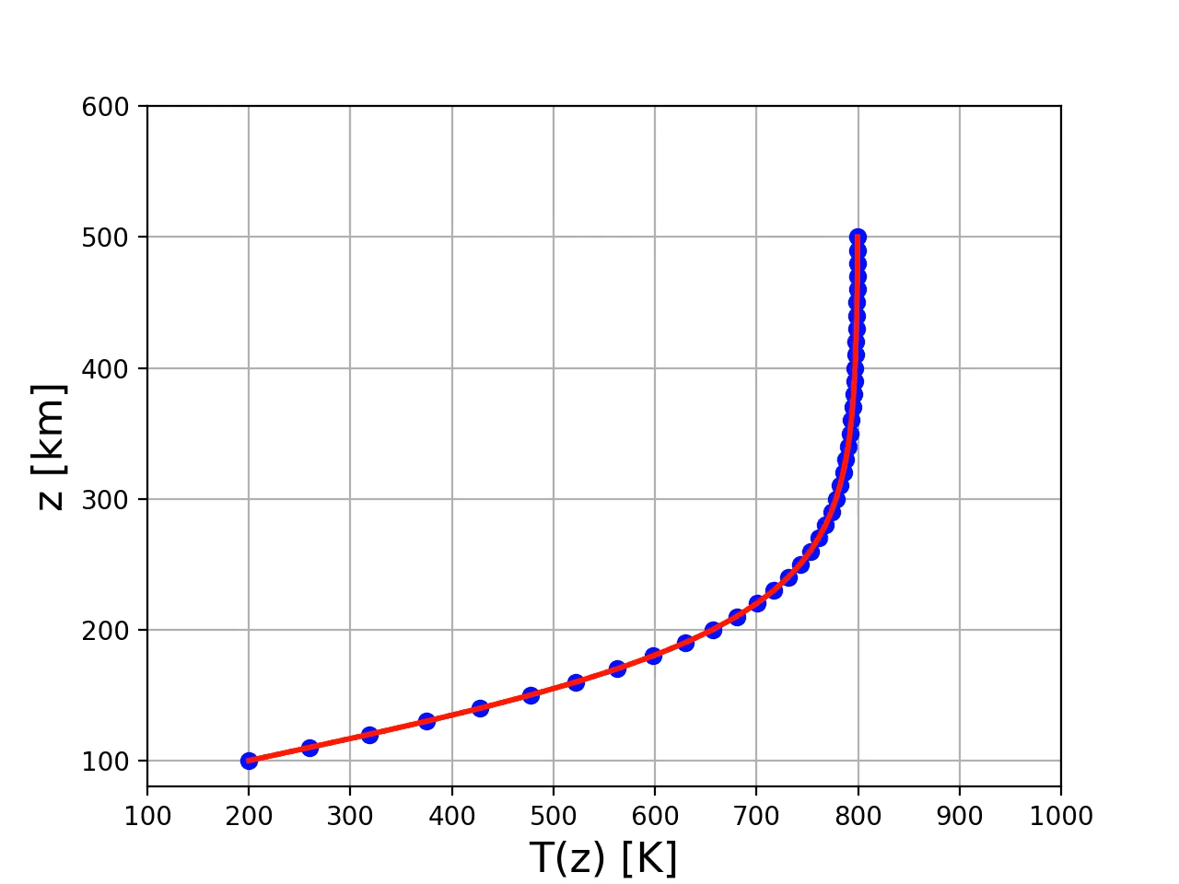
Model Output Animation
Without SZA consideration

Slide 6

Model Output Animation Cont’d
With SZA consideration

Slide 7
Thanks

